Slide 1
Reimbursement Policy

Slide 2
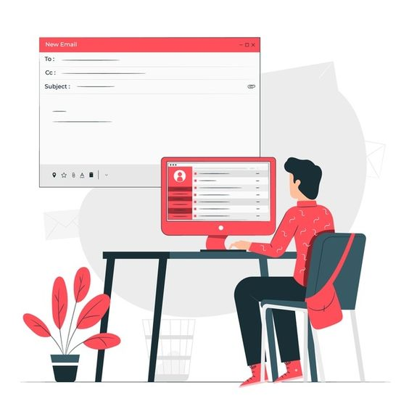

The Approval Process (Reimbursement Policy)
All business expense must be pre-approved before the event date. Except Well-being Benefit.
1
Operations Approval
For all operational expenses, Hive Master and Final at COO must approve before the event date.
Support Approval
Hive Master and Final at P&C Lead must approve all support expenses before the event date.
Final Approval
All exceptions must be approved by the Managing Director before they can be considered final and reimbursed.
2
3

Slide 3



Types of Expenses Covered (Reimbursement Policy)
1
Well-being Includes gym memberships, mental health services, meal, and other wellness-related expenses (No cash card or any Online money form) (Minimum 2,000 THB/ Request)
2
Professional Development
Includes conference fees, training courses, and other career development
Required for Pre-approval
CC: Admin Team
3
Travel Expenses
Includes airfare, hotel, meals, and other travel-related costs Required for Pre-approval
CC: Admin Team Travelling Policy & Allowance

Slide 4



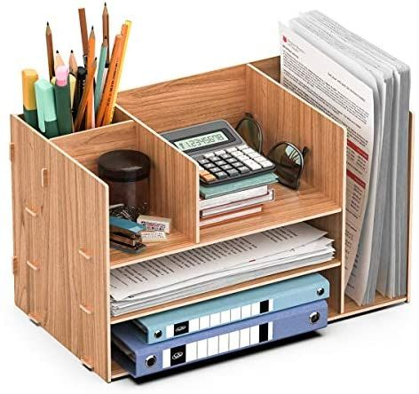

Types of Expenses Covered (Reimbursement Policy)
4
Stationaries & Miscellaneous
Stationery items will be purchased for you by the Company. Without approval from your Hive Master or the Admin team, no reimbursement will be provided if you purchase the stationery items.
All printing of business cards, project documents, marketing support, and other miscellaneous items must be pre-approved.

Slide 5

Types of Expenses Covered (Reimbursement Policy)
5
Team & Client Meals / Activities
Quarterly Team / Client Meals / Activities
Budget: Lunch 500 THB/ Head, Dinner 1,000 / Head all inclusive! Document request:
Approval Email from Hive Master & COO CC: Admin Team with List of attendees and group photos.
Original copy of Tax invoice under Palo IT (Thailand)'s address
Submitted through the FITNET portal within 30 days, and no later than the 20th of each month

Slide 6
Non-Reimbursement Expense
(Reimbursement Policy)
X
Personal expenses
X
Entertainment, meals, travels expenses not related to Company’s business
X
Unapproved expenses
X
Medical bills not covered by our medical policy
X
Mobile bills

Slide 7
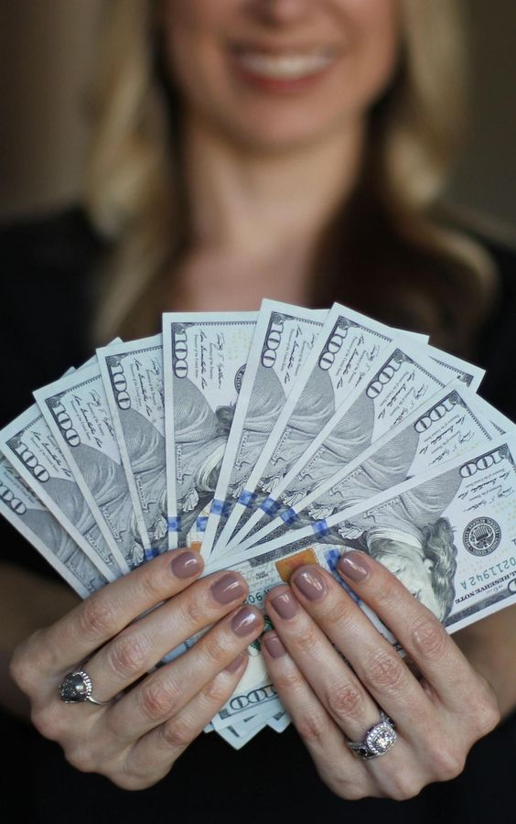
Reimbursement Policy (Con.)
Reimbursement Process
To be reimbursed effectively, your business expenses must be submitted through the FITNET portal within 30 days, and no later than the 20th of each month. For Well-being reimbursement, Request Claim via Fitnet with Receipt (Picture) attached in system only , no original document and tax receipt request to submit.
For Others, You must keep all original documents for compliance purposes. Make sure you request a tax receipt and that it is completed as below:
PALO IT (THAILAND) LTD. - Head office
159/37 Serm-Mit Tower, 23rd Floor, Room No. 2301, Sukhumvit 21 Road (Asoke), Khlong Toei Nuea Sub-District, Wattana District, 10110 Bangkok
TAX ID : 0105561014055

Slide 8

REIMBURSEMENT EXPENSES

Slide 9

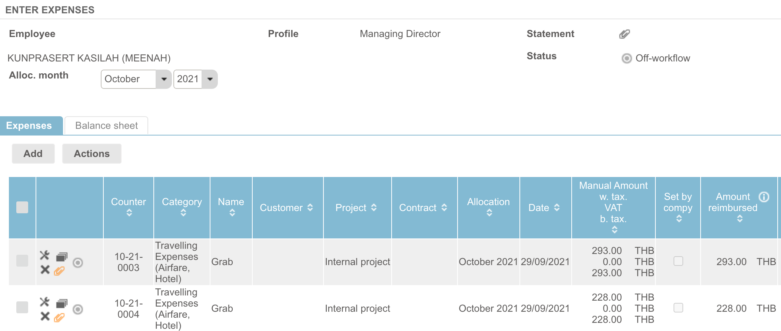


Reimbursement, Expenses Page
FITNET Reimbursement
1. CHOOSE " EXPENSES "
2. CLICK "ADD"
3. STATUS FOR APPROVAL

Slide 10
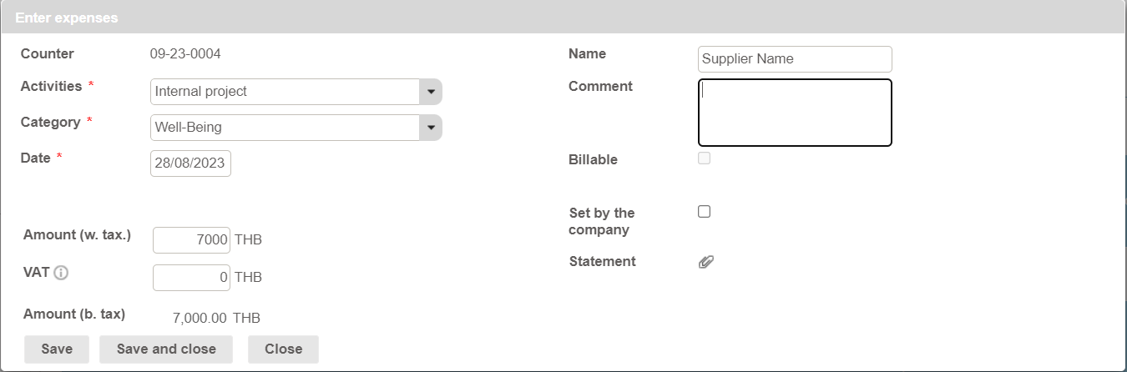
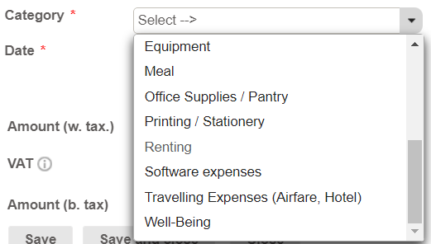
Filling The number reimbursement expenses
FITNET Reimbursement

Slide 11
Filling The number reimbursement expenses
FITNET Reimbursement
3. Fill Supplier Name
1. Fill Total amount with VAT
2. No Vat fill "0"
4. Click "Save and Close"

Slide 12
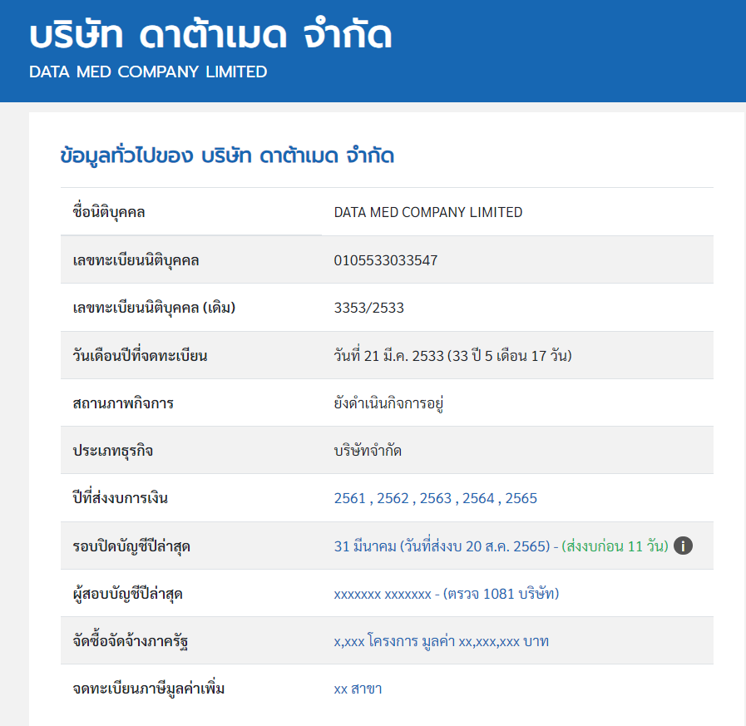
Supplier Name
FITNET Reimbursement

Slide 13
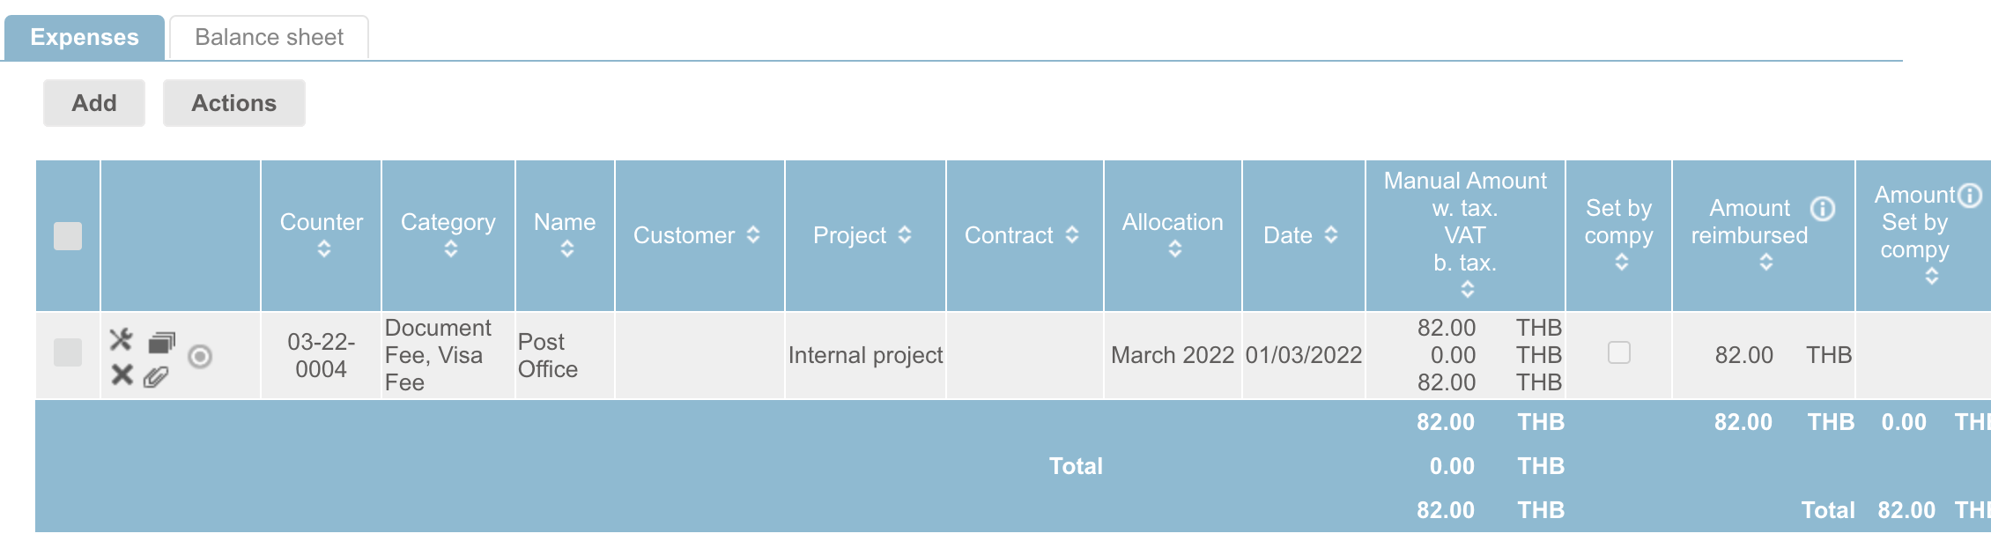
Do not forget to attach the files , otherwise there is no reimbursement
FITNET Reimbursement
Do not forget to attach the tax invoice receipt with JPG , Pdf , etc.
Click "Paper Clip Icon"

Slide 14
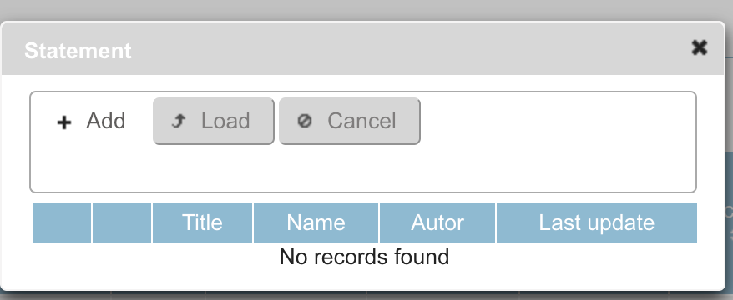
How to attach the file ?
FITNET Reimbursement
1. Click "Add" and Select "An attached file
2. Click "Load"

Slide 15
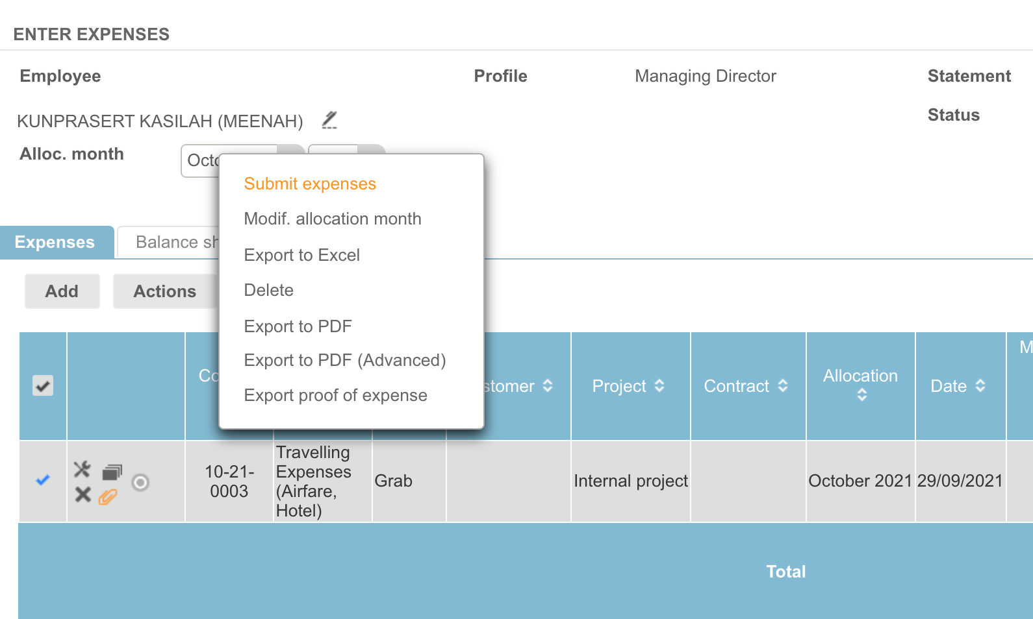
Submit Expenses for Wellbeing benefits
FITNET Reimbursement
before the 20th each month
with the original receipts

Slide 16
Things you need to know. !!
FITNET Reimbursement
◎ The Reimbursement request to submit before the 20th each month with the original tax receipts and must be issued at the address below;
PALO IT (THAILAND) LTD. (Head office)
159/37 Serm-Mit Tower, 23rd Floor, Room No. 2301,
Sukhumvit 21 Road (Asoke),
Khlong Toei Nuea, Wattana, Bangkok 10110
Tax ID: 0105561014055
บริษัท พาโล ไอที (ไทยแลนด์) จำกัด (สำนักงานใหญ่)
159/37 อาคารเสริมมิตร ทาวเวอร์ ชั้นที่ 23 ห้องเลขที่ 2301
ถนนสุขุมวิท 21 (อโศก) แขวงคลองเคยเหนือ เขตวัฒนา กรุงเทพมหานคร
เลขประจำตัวผู้เสียภาษี 0105561014055

